Slide 5
http://www.youtube.com/watch?v=3Fen_p0UMwI
5 X

Slide 6
Explanations
Images and
Videos
My Opinion
New Media in the English classroom

Slide 7
Explanations
Images and
Videos
My Opinion
New Media in the English classroom

Slide 8
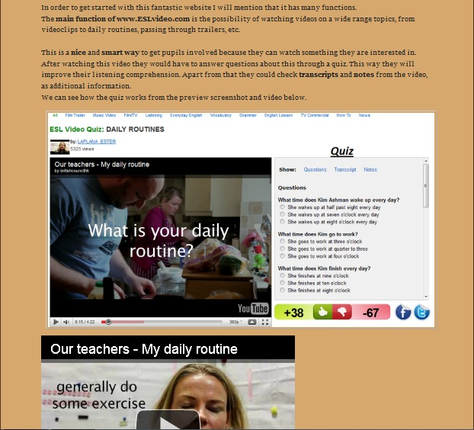

Slide 9
Explanations
Images
Downloadable files
Presenting Contents

Slide 10
Explanations
Images
Downloadable files
Presenting Contents

Slide 11
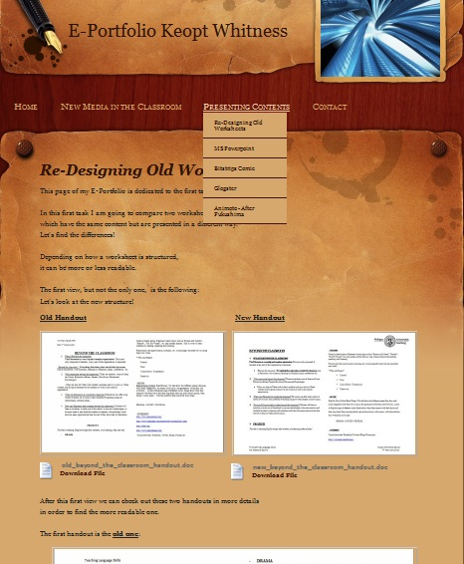

Slide 12
